Slide 1
Covid Cases Prediction
Rui Chen

Slide 2
Project Overview
Idea is according to 2021 spring HUNG-YI LEE. https://speech.ee.ntu.edu.tw/~hylee/ml/2021-spring.php
Objectives: Solve a regression problem with deep neural networks (DNN).

Slide 3
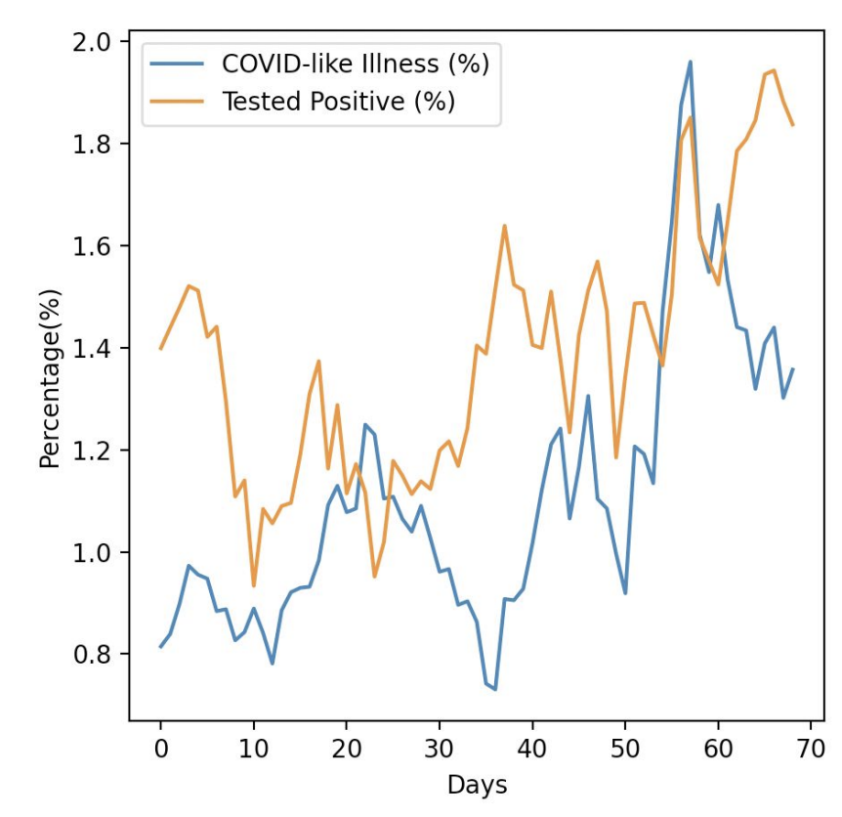
Task Description
COVID-19 Cases Prediction
Source: Delphi group @ CMU ○ A daily survey since April 2020 via facebook.
Given survey results in the past 3 days in a specific state in U.S., then predict the percentage of new tested positive cases in the 3rd day.

Slide 4
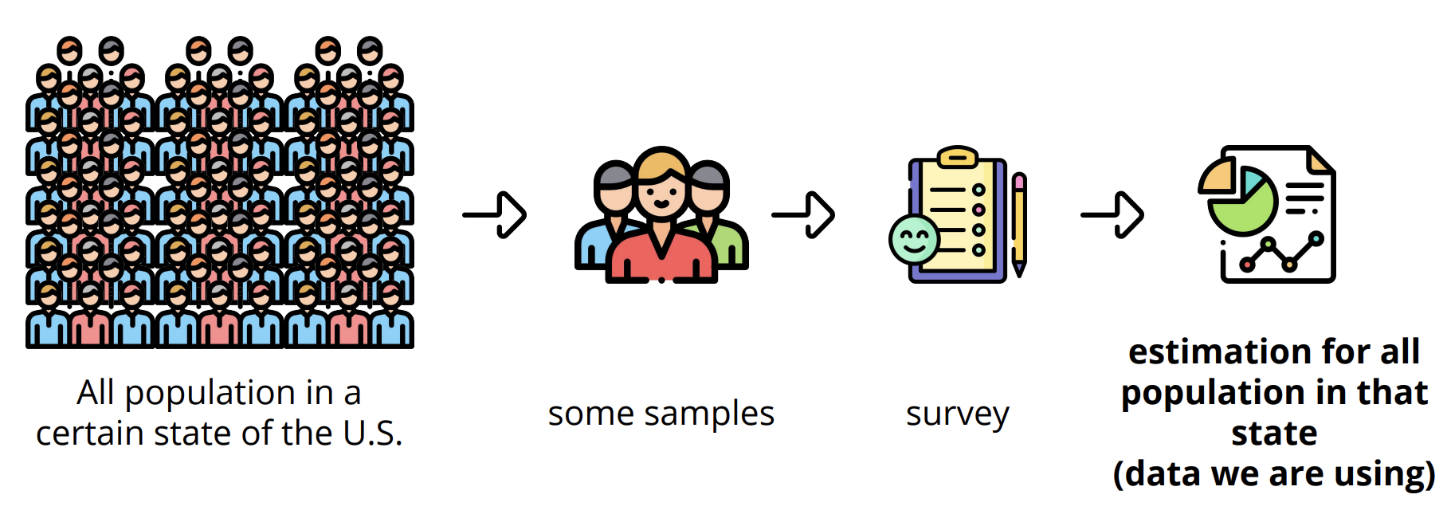
Data Description
Conducted surveys via facebook (every day & every state)
Survey: symptoms, COVID-19 testing, social distancing, mental health, demographics, economic effects, ...

Slide 5
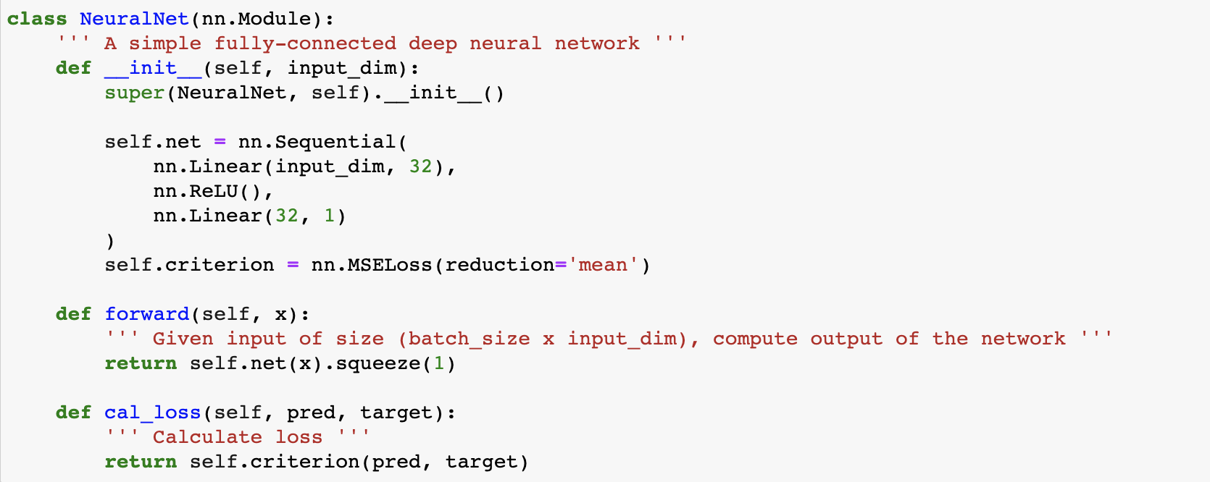
DNN Description

Slide 6
Improvement on Original Project
Instead of using whole dataset, target only is implemented
Instead of using RMSE, L2 regularization is implemented
Modified hyperparameters including learning rate and max epoch
Modified number of neuros in hidden layers to reduce overfitting
Test RMSE is reduced from 2.01 to 1.06

Slide 7
References
https://github.com/Fafa-DL/Lhy_Machine_Learning

